Slide 1
Final Project
DLCV Fall 2020

Slide 2
Important Deadlines
Poster Submission Deadline 2021/1/17 20:00 GMT+8
Kaggle Challenge Deadline 2021/1/21 11:59 GMT+8
Poster Presentation 2021/1/21 1-5pm
GitHub Commit Deadline 2021/1/22 11:59 GMT+8

Slide 3
Introduction
About the final project
Challenges
Challenge 1 Face Anti-Spoofing
Challenge 2 Medical Imaging

Slide 4
About Final Project
GitHub
Kaggle
Poster
Presentation
Code / Report*
Grading
Challenge Awards
Intra/Inter-Team Evaluation
Rules

Slide 5
GitHub
Each team needs to come up with a team name...
English alphabets and numbers only
You need to use the same team name for Kaggle.
The team leader creates the team first, and the team members join the team afterwards.

Slide 6
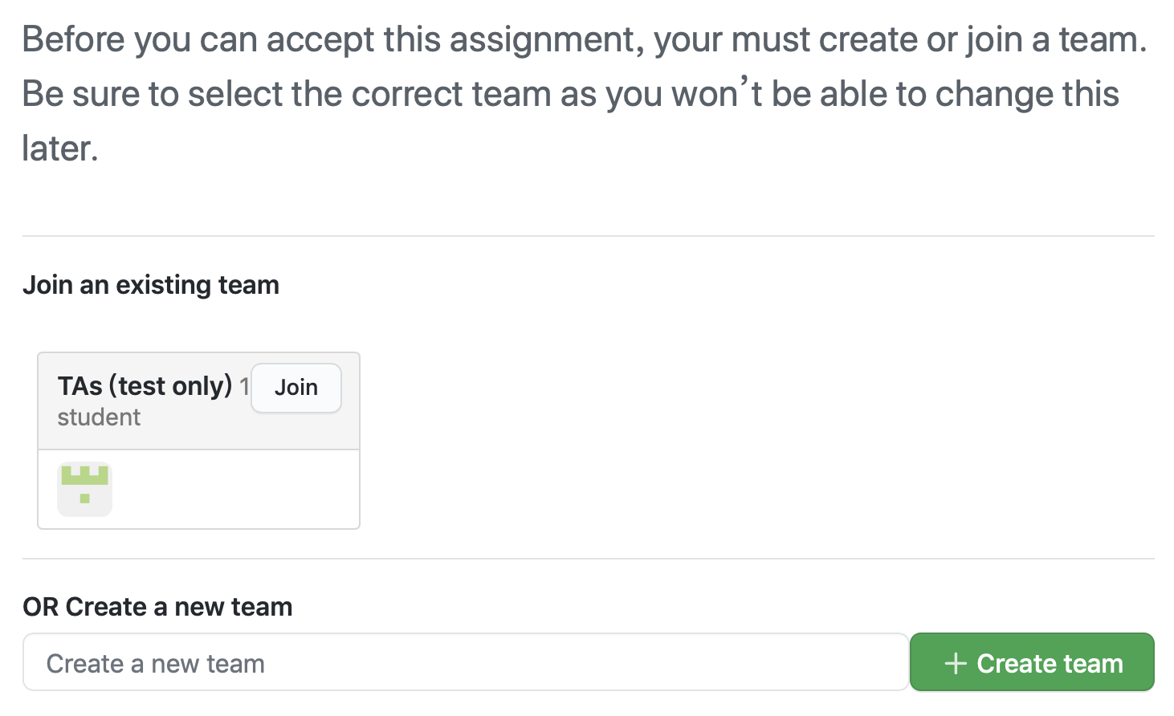
If you are a team leader,
1. Enter your team name here
2. Click “Create team”

Slide 7
If you are a team member,
WARNING
Do not join any team unless your team leader has already created the team.
Do not join a team without asking its leader or members.
Do not join the TA team.
1. Make sure you find the correct team
2. Click “Join”

Slide 8
GitHub Link
Before you click the link, make sure that you’ve read the instructions thoroughly.
You may not undo anything. Do not make any unintended mistakes.
Challenge #1 https://classroom.github.com/g/Zw-5Goo2 Challenge #2 https://classroom.github.com/g/gRVlaBB3

Slide 9
Kaggle
You need to participate the kaggle challenge and compete with your classmates!
Maximum Daily Submissions: 5 times (for each team)
Reset at 08:00 AM (GMT+8) every day
Challenge deadline: 2021/1/21 11:59 GMT+8

Slide 10
Kaggle
Kaggle Links
Challenge #1 https://www.kaggle.com/t/c35114f220fa472f8c04ccf13f54460c
https://www.kaggle.com/t/b1dc7f31513b46d09243868360854fc8 Challenge #2 https://www.kaggle.com/t/21f9e7de7c704956a518eee71cff0494
The team leader should create a team on Kaggle with the same team name as in the GitHub Classroom.
It is strictly prohibited for members in the same team to create multiple teams on Kaggle.

Slide 11
Poster
Format : A1 (Portrait, 84.1 cm x 59.4 cm)
Submission:
You should convert your file into PDF format for submission.
The poster should be submitted in the team’s Github repository (should be in the format poster.pdf).
You may leave some blank areas on your poster (e.g., recognition rates) and fill them up before the final presentation.
If you fail to submit your poster before the submission deadline, you need to print it out by yourself (i.e., using your own budget).

Slide 12
Presentation
Date 2021/1/21 1-5pm
Location EE2-142 (電機二館 142)
More details about poster sessions and final presentation will be announced in the next few weeks.

Slide 13
Code/Report*
The code should be submitted in the team’s Github repository.
You need to modify the "How to run your code?" part of the README file, so that TAs will be able to reproduce your results.
If TAs cannot reproduce your results, you will receive 0 points in the code part. (unless minor errors)

Slide 14
Code/Report*
For the top 3 teams selected for cash awards, an additional technical report needs to be submitted to Github as well (by 1/27 Wed; single-column, 4 pages maximum)
Approach (e.g., data preprocessing, model architecture, implementation details, hyperparameter choices, etc.)
Experiments
A template will be provided.
Template: Link

Slide 15
Grading
Relative ranking (Public / Private)
Score | Points | Challenge #1 | Challenge #2
 | 2.5% | 4 | 4
 | 2.0% | 4 | 4
 | 1.5% | 4 | 4
 | 1.0% | 4 | 3
 | 0.5% | 3 | 3
Final 35% (Bonus up to 3%)
Code / Kaggle 10% Kaggle for references, final accuracy evaluated by TAs
Baseline 5% (Public 2.5% / Private 2.5%)
Relative ranking in the class 5% (Public 2.5% / Private 2.5%)
Approach & Presentation 25%
Novelty and technical contribution 10%
Completeness of experiments 10% (e.g., comparisons to baseline and recent models, ablation studies, visualization, etc.)
Presentation (Oral + Poster) 5% + bonus up to 3% (top 3 teams voted by class)
highest
lowest
(number of teams)

Slide 16
Challenge Awards
Top 3 teams of each challenge (by judges) will receive cash prizes
1st: NTD $10k
2nd: NTD $5k
3rd: NTD $3k

Slide 17
Intra/Inter-Team Evaluation
Intra-Team Evaluation
You must participate and work with your team member.
In the past few semesters, we did assign different scores for team members within the same team.
Inter-Team Evaluation
The most voted team from each challenge will receive bonus points.
Will provide an online form during final presentation (one form per team)

Slide 18
Rules
Please submit your final project to the GitHub repository by the deadline. You will not have any late days, so late submission is not allowed. Besides, any mistake or violation will result in severe penalty (which means your results are questionable).
For each team, if no members show up for the final presentation, all team members will receive 0 points for this part (0 out of 25 points).

Slide 19
Rules -- Packages
python: 3.6
numpy: 1.18.1
torch >= 1.4.0
torchvision >= 0.5.0
cudatoolkit: 10.1
scikit-learn: 0.21.3
pandas: 1.1.3
and other standard python packages
E-mail or ask TA first if you want to import other packages.
matplotlib: 3.3.2
pillow: 8.0.0
imageio: 2.9.0
scipy: 1.2.1
tqdm: 4.54.0

Slide 20
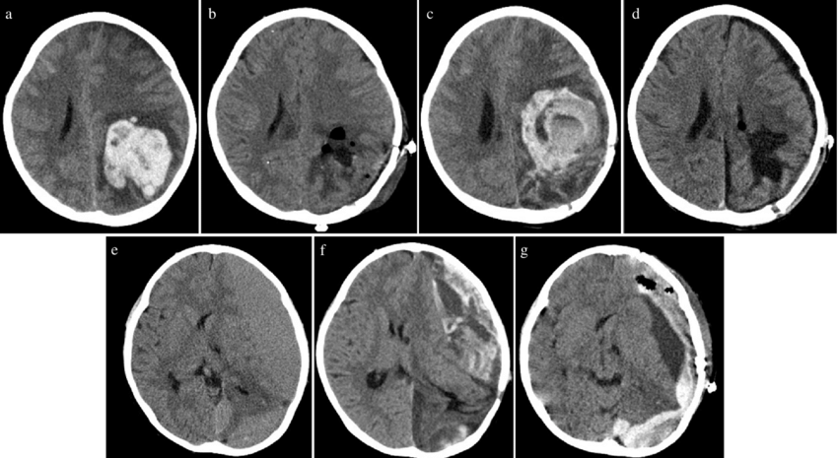
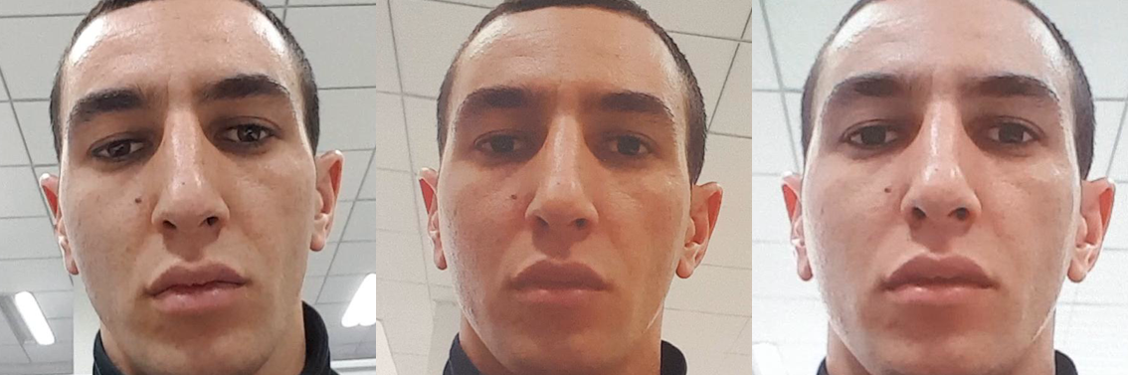
Tasks
Challenge 1 Face Anti-Spoofing (Classification, domain transfer, sequence model, etc.)
Challenge 2 Medical Imaging (Multi-label classification, sequence models, etc.)

Slide 21
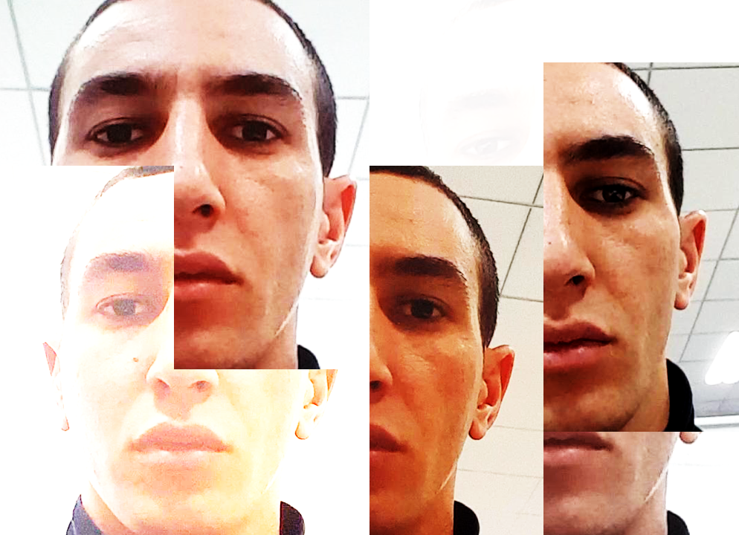

Challenge I
Face Anti-Spoofing
Sponsered by
Microsoft AI Research Center

Slide 22
Outline
Introduction
Dataset
Evaluation
Rules
Related Papers

Slide 23
Introduction
In general, face anti-spoofing is a two-class classification task.
Real: Face images which are directly captured by cameras.
Fake: Face images which are remade from printed photos, replay-videos, etc.
Goal: Train a model for telling whether input images are Real or Fake. The task contains 2 datasets; one for both training and testing, and one for testing only.
Task: Classification

Slide 24
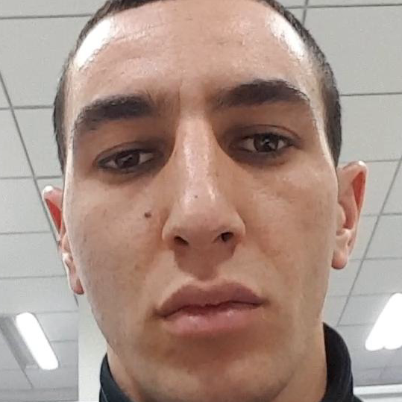
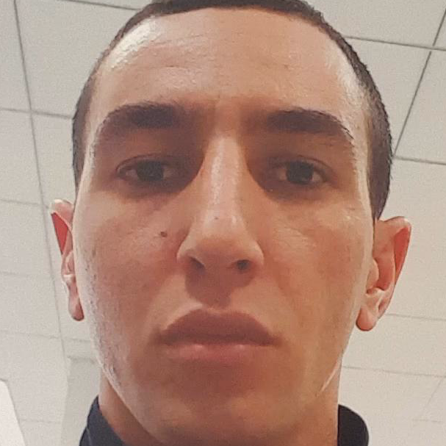
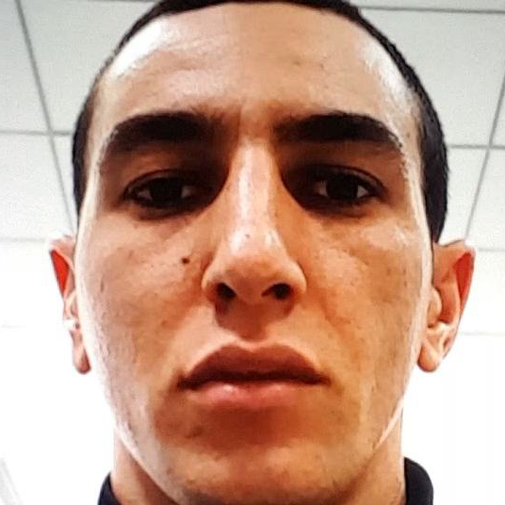
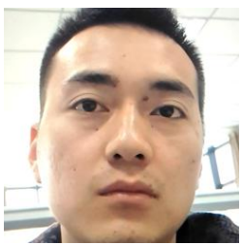
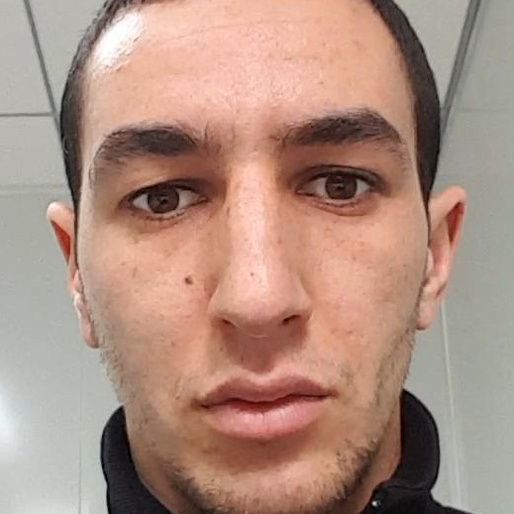
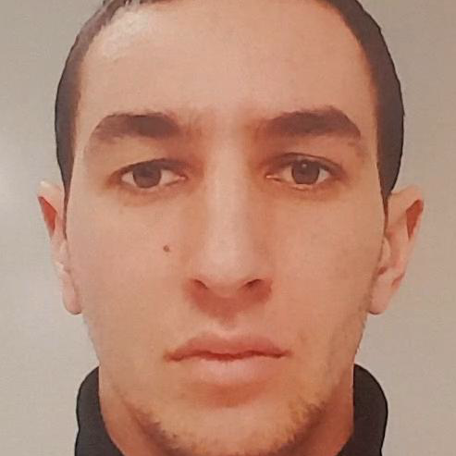
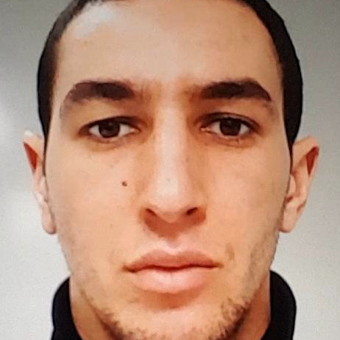
What's different from a simple classification task?
For images sampled from the same video, they can be viewed as sequential data. Make use of them!
Test data can be from unseen domains. Some clues from training data (hue, lighting, contrast) might not work for testing data. --> Domain adaptation or generalization
Training set domain
real face
fake_print
fake_replay
Testing set domain
?

Slide 25
Dataset
OULU-NPU (for training and testing) [download link]
Face images sampled from videos. 11 frames sampled from each video.
Videos are captured by 6 different phones, 3 different acquisition conditions (session 1~3), and 5 different access type (real, print1, print2, replay1, replay 2).
Training:
20 different IDs (#1~#20), only session 1 and 2, in total of 6*2*20*5*11 = 13200 frames.
Validation:
15 different IDs (#21~#35), only session 1 and 2, in total of 6*2*15*5*11 = 9900 frames.
Testing:
20 different IDs (#36~#55), only session 3, in total of 6*1*20*5*11 = 6600 frames.
oulu_npu_cropped.zip

Slide 26
Dataset -- OULU-NPU’s File Structure
oulu_npu_cropped/
├── train/
│ ├── 1_1_01_1/
│ │ ├── 020.png
│ │ └── ...
│ └── .../
├── val/
│ ├── 1_1_21_1/
│ │ ├── 013.png
│ │ └── ...
│ └── .../
├── test/
│ ├── 0000/
│ │ ├── 004.png
│ │ └── ...
│ └── .../
│
└── example.csv
Training Directories
{phone}_{session}_{human ID}_{access type}, images named XXX.png
Validation Directories
{phone}_{session}_{human ID}_{access type}, images named XXX.png
Testing Directory
directories named xxxx,images named XXX.png
output example

Slide 27
Dataset (cont’d)
SiW: Spoofing in the Wild Database (only for testing) [download link]
Face images sampled from videos. 10 frames sampled from each video.
Testing:
2053 videos, in total of 2053*10 = 20530 frames
File Structure:
siw_test/
├── 0000/
│ ├── 0085.png
│ └── ...
└── .../
Testing Directory
directories named xxxx,images named XXXX.png

Slide 28
Evaluation
Predict labels of the images sampled from videos in the testing set (one label per one video)
AUC (Area Under ROC Curve) between the predicted result and the ground truth (the higher, the better).

Slide 29
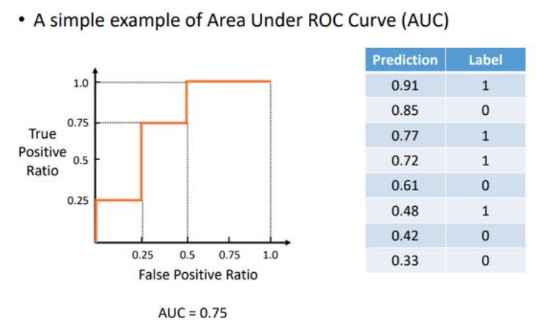
Evaluation
AUC（Area Under ROC Curve）
A simple example of AUC calculation
There’re 8 testing samples and
their predicted probability of being positive.
If threshold = 0.91, TPR = 1/4, FPR=0/4,
=> (0.0, 0.25)
If threshold = 0.85, TPR = 1/4, FPR=1/4,
=> (0.25, 0.25)
and so on… We could eventually plot the ROC curve and calculate the corresponding AUC value.

Slide 30
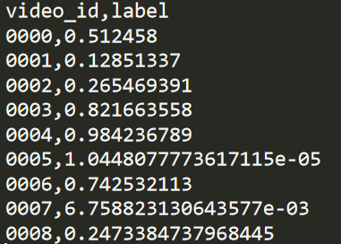
Evaluation
Predict labels of the images sampled from videos in the testing set (one label per video)
Output a .csv file with the same format as example.csv
Note that your predicted labels should be the probability of being positive (REAL).
That is, each label should be between [0, 1]

Slide 31
Evaluation
We host 2 competitions on Kaggle for Oulu and SiW datasets seperately.
Task 1 (for SiW )
Baseline AUC: 0.87067 (Public)
Task 2 (for Oulu )
Baseline AUC: 0.97421 (Public)
You need to pass both the baseline of task1 and task2 on public leaderboard to get 2.5%. Otherwise, you’ll get 0%. The same rule shall apply to the private leaderboard.

Slide 32
Evaluation
For the Relative ranking score, we’ll calculate the weighted rank. (70% for SiW; 30% for Oulu)
e.g., Your team rank #10 in SiW task, and #1 in Oulu task on the public leaderboard . Your weighted average rank will be 10*0.7+1*0.3=7.3. The final relative ranking will based on the weighted average rank of each team.
The same rules shall apply to the private leaderboard.

Slide 33
(Very Important) Rules
You are NOT allowed to
Use validation data and test data for training.
Use any pretrained models or other dataset related to ANTI-SPOOFING for training.
(That is, ImageNet pretrained model is allowed)
Your models and scores need to be reproducible.
Any violation would result in 0 score for your final project!!

Slide 34
(Selected) Reference Papers
J. Yang, Z. Lei, and S. Z. Li, “Learn convolutional neural network for face anti-spoofing,” arXiv preprint arXiv:1408.5601, 2014 [link]
X. Yang, W. Luo, L. Bao, Y. Gao, D. Gong, S. Zheng, Z. Li, and W. Liu, “Face anti-spoofing: Model matters, so does data,” in CVPR. IEEE, 2019 [link]
A. Jourabloo, Y. Liu, and X. Liu, “Face de-spoofing: Anti-spoofing via noise modeling,” in ECCV. Springer, 2018. [link]

Slide 35

Medical Imaging
Final Challenge #2
Sponsered by Deep01

Slide 36
Outline
Introduction
Challenges
Dataset
Evaluation
Special Challenge/Awards
Rules
TAs' experience
Related Papers

Slide 37
Introduction
Dataset Computer tomography (電腦斷層影像) of different patients with cerebral hemorrhage (腦部出血).
Goal Train a neural network to classify 5 classes of cerebral hemorrhage by utilizing data annotated by physicians.
Task Multi-label classification
Cerebral hemorrhage can be roughly divided into 5 categories:
Intracerebral hemorrhage (ICH) 腦內出血
Intraventricular hemorrhage (IVH) 腦室出血
Subarachnoid hemorrhage (SAH) 蜘蛛膜下出血
Subdural hemorrhage (SDH) 硬膜下出血
Epidural hemorrhage (EDH) 硬膜外出血

Slide 38
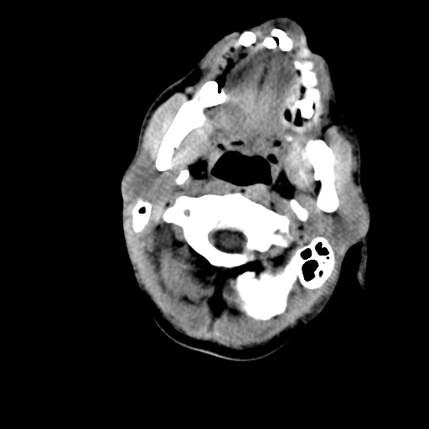
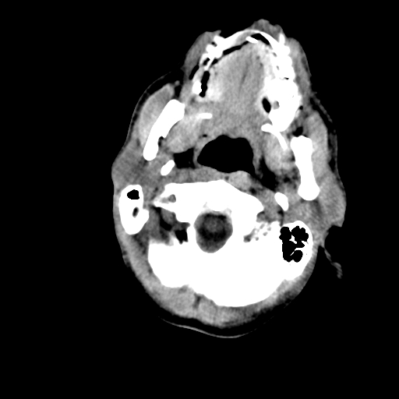
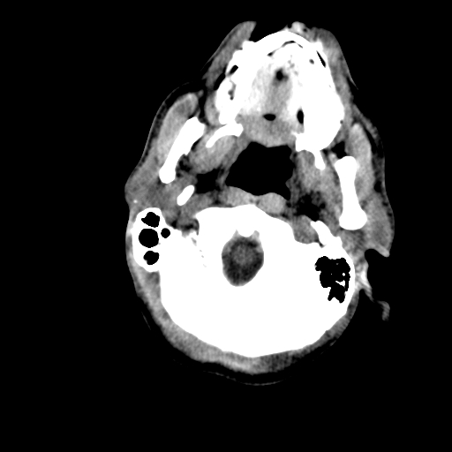
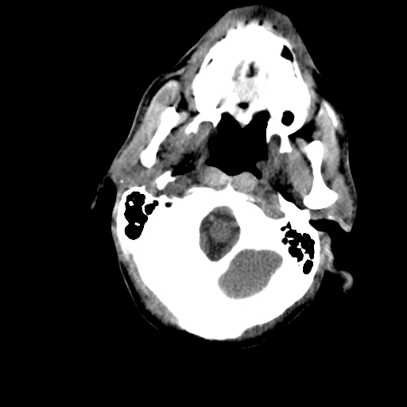
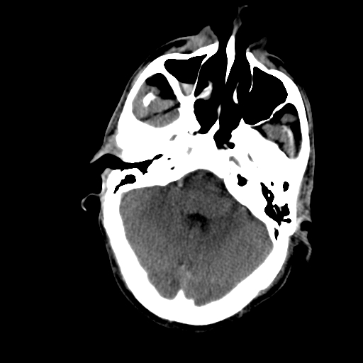
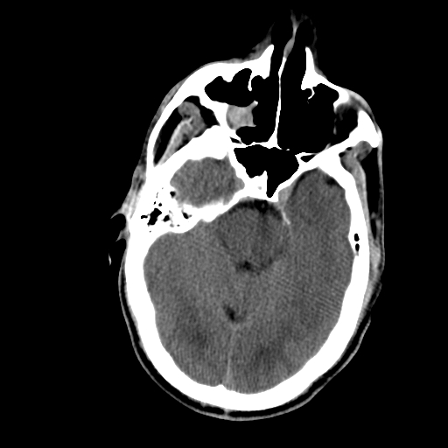
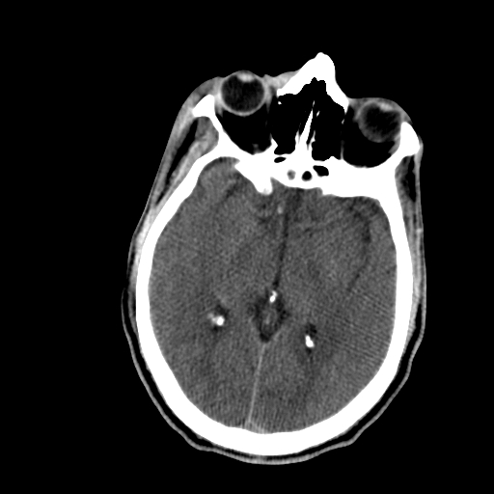
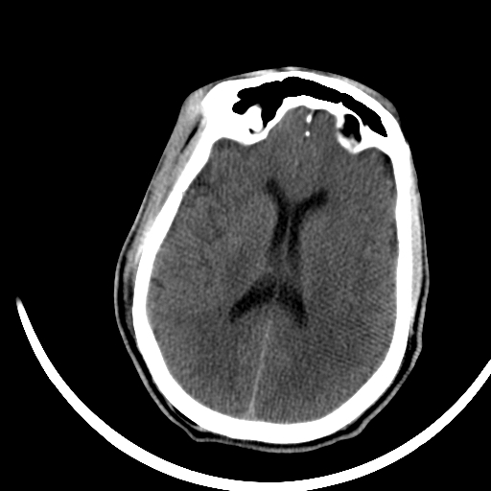
Challenges - Things are not that easy!
Medical images are quite different from those in COCO or Visual Genome datasets. (e.g., RGB images)
Imbalanced data is a common problem in medical image classification (or many real-world applications).
Correlation between classes may be useful for multi-label classification.
CT images can be viewed as sequential data:
If you treat each frame as independent inputs, performance may be limited.
However, different classes may depend on different sections of the frames.

Slide 39
Dataset
CT images of different patients with cerebral hemorrhage
Training set (with label)
1,535 patients, with 50,492 images in total
Testing set (without label)
768 patients, with 25,053 images in total
Download link https://drive.google.com/file/d/1XY5twJuNLU-tJL-sr5-efTMPqbOtodS6/view?usp=sharing

Slide 40
Dataset -- File Structure
Blood_data/
├── train/
│ ├── ID_1a5f473417/
│ │ ├── 1a5f473417_0.jpg
│ │ └── ...
│ └── .../
├── test/
│ ├── ID_1a1b17b853/
│ │ ├── 1a1b17b853_0.jpg
│ │ └── ...
│ └── .../
├── train.csv
└── train_small.csv
Training Images
{patientID}_{imageID}.jpg
Testing Images
{patientID}_{imageID}.jpg
One image can belong to more than one class!
Training Labels
dirname,ID,ich,ivh,sah,sdh,edh
{ID_patientID},{image_name},{label_1},...,{label_5}
e.g., ID_b8d803a9b7,b8d803a9b7_20.jpg,1,1,0,0,0

Slide 41
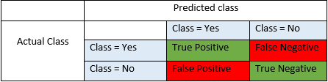
Evaluation
Predict the label of images in the test set and submit the results to Kaggle.
Output a .csv file with the same format as train.csv
Convert to the Kaggle formate by using to_kaggle.py.
Slice level (i.e., with an image as a unit, not a patient)
Metrics Fbeta-score (beta = 2)
Precision = TP/(TP+FP)
Recall = TP/(TP+FN)
Fbeta Score = (1+beta^2)*(Recall * Precision) / (Recall + beta^2*Precision)
Baseline F2-score: 0.69276 (Public)

Slide 42
Evaluation (cont'd)
Example for Fbeta-score (beta = 2)
Precision = 3/7, Recall = 3/3
F1-score = 2*P*R/(P+R) = 0.6, F2-score = 5*P*R/(4*P+R) = 0.789
Prediction
GT
ID | cls1 | cls2 | cls3 | cls4 | cls5
0 | 0 | 0 | 0 | 0 | 0
1 | 0 | 1 | 1 | 0 | 0
2 | 0 | 1 | 1 | 1 | 0
3 | 0 | 0 | 1 | 1 | 0
4 | 0 | 0 | 0 | 0 | 0
ID | cls1 | cls2 | cls3 | cls4 | cls5
0 | 0 | 0 | 0 | 0 | 0
1 | 0 | 0 | 0 | 0 | 0
2 | 0 | 0 | 1 | 1 | 0
3 | 0 | 0 | 0 | 1 | 0
4 | 0 | 0 | 0 | 0 | 0

Slide 43
(Optional) Special Challenge/Awards
Learning from small amount of labeled data (e.g., semi-supervised setting)
For the teams working on this part, depending on your efforts, additional 1~3 points will be received.
The team presenting the most effective models will receive an additional NTD $5,000 from Deep01!
We provide a small train data label (in Blood_data/train_small.csv) for you to perform the semi-supervised setting.

Slide 44
(Super Important) Rules
Do not disclose the dataset! Dataset 請勿外流！
You are NOT allowed to use any pretrained models or data related to computer tomography, but other types of pretrained models or datasets (e.g., MRI, ImageNet, etc.) are OK.
Your models and scores need to be reproducible.
Any violation would result in 0 score for your final project!!

Slide 45
TAs' Experience
You don't need to use very powerful backbone for this task. The reasons are shown below:
All images are grayscale (less information than color images). It is easy to overfit the training data when using strong backbones such as EfficientNet-b4 and ResNeXt101.
It is time-consuming to use very deep backbones.
The input size of images would affect the performance significantly. Please choose your input size carefully.
Some information about baseline model:
GPU device: 1*1080Ti
Backbone: Resnet-18
Input size: 512 * 512
Epochs: 20
Batch size: 48
Objective function: BCELoss w/ loss reweighting on positive and negative sample.

Slide 46
(Selected) Related Papers
Medical Imaging
Haghanifar, Arman, Mahdiyar Molahasani Majdabadi, and Seokbum Ko. "Covid-cxnet: Detecting covid-19 in frontal chest x-ray images using deep learning." arXiv preprint arXiv:2006.13807 (2020). LINK
Li, Jianqiang, et al. "A multi-label classification model for full slice brain computerised tomography image." BMC bioinformatics 21.6 (2020): 1-18. LINK
Sugimori, Hiroyuki. "Classification of computed tomography images in different slice positions using deep learning." Journal of healthcare engineering 2018 (2018). LINK
Ibrahim, Walaa Hussein, Ahmed AbdelRhman Ahmed Osman, and Yusra Ibrahim Mohamed. "MRI brain image classification using neural networks." 2013 international conference on computing, electrical and electronic engineering (ICCEEE). IEEE, 2013. LINK
Zhang, Yudong, et al. "A hybrid method for MRI brain image classification." Expert Systems with Applications 38.8 (2011): 10049-10053. LINK
Saritha, M., K. Paul Joseph, and Abraham T. Mathew. "Classification of MRI brain images using combined wavelet entropy based spider web plots and probabilistic neural network." Pattern Recognition Letters 34.16 (2013): 2151-2156. LINK
Wei, Dong, et al. "Learning and Exploiting Interclass Visual Correlations for Medical Image Classification." International Conference on Medical Image Computing and Computer-Assisted Intervention. Springer, Cham, 2020. LINK

Slide 47
(Selected) Related Papers
Multi-label Classification
Ben-Baruch, Emanuel, et al. "Asymmetric Loss For Multi-Label Classification." arXiv preprint arXiv:2009.14119 (2020). LINK
Chen, Zhao-Min, et al. "Multi-label image recognition with graph convolutional networks." Proceedings of the IEEE Conference on Computer Vision and Pattern Recognition. 2019. LINK
Wang, Jiang, et al. "Cnn-rnn: A unified framework for multi-label image classification." Proceedings of the IEEE conference on computer vision and pattern recognition. 2016. LINK

Slide 48
Have fun !

